Slide 1
Announcements
9th and 10th Grade PSAT Weds. Feb. 24th from 8:40-12 PM

Slide 2
Keep yourself healthy and Happy
Today’s goal is EXERCISE MORE!
Last week’s goals:
EAT YOUR BREAKFAST
DRINK MORE WATER

Slide 3
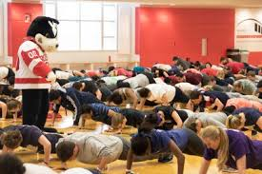
Exercise More
The recommendation for students 6 to 17 years old is 60 minutes of physical activity every day.
Even though, you may not get 60 minutes, just a few exercises every day can lead to a healthier, happier YOU.

Slide 4
Benefits of exercise
Benefits of Physical Activity:
Improve Cardiorespiratory fitness
Build strong bones and muscles
Control Weight
Reduce symptoms of Anxiety and Depression

Slide 5
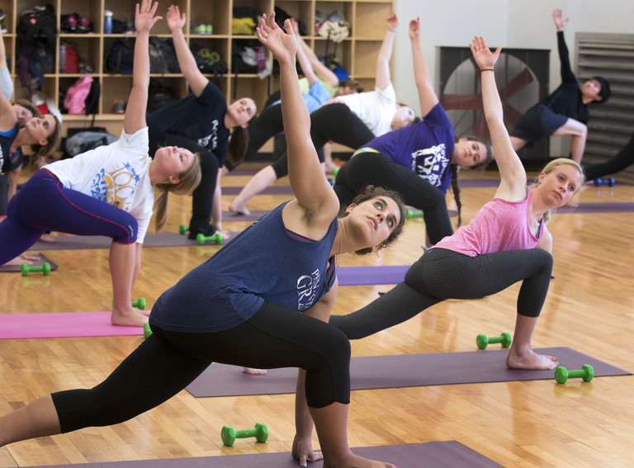
Benefits of exercise
Also, exercise can reduce the risk of these health conditions:
Heart Disease
Cancer
Type 2 Diabetes
High Blood Pressure
Obesity

Slide 6
Ways to Exercise
Get on your bike
Take a walk or jog around the neighborhood
Walk your dog
Do an online yoga class

